Slide 1



Agri DASH
NASA SPACE APPS 2024
Leveraging Earth Observation data for informed agricultural decision-making
Amish Electricians
Start Now

Slide 2



Agri DASH
MEET OUR TEAM
Dominic Beninanti
Rahul Vemuri
Zeel Prajapati

Slide 3
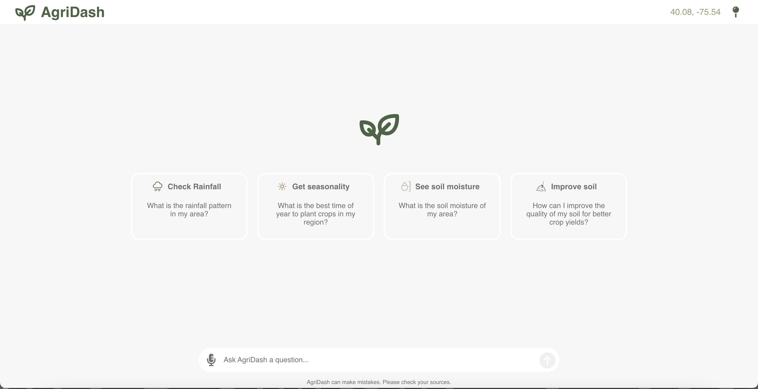
AGRI DASH
Proposed Solution
A Farmer Friendly Chatbot

Slide 4
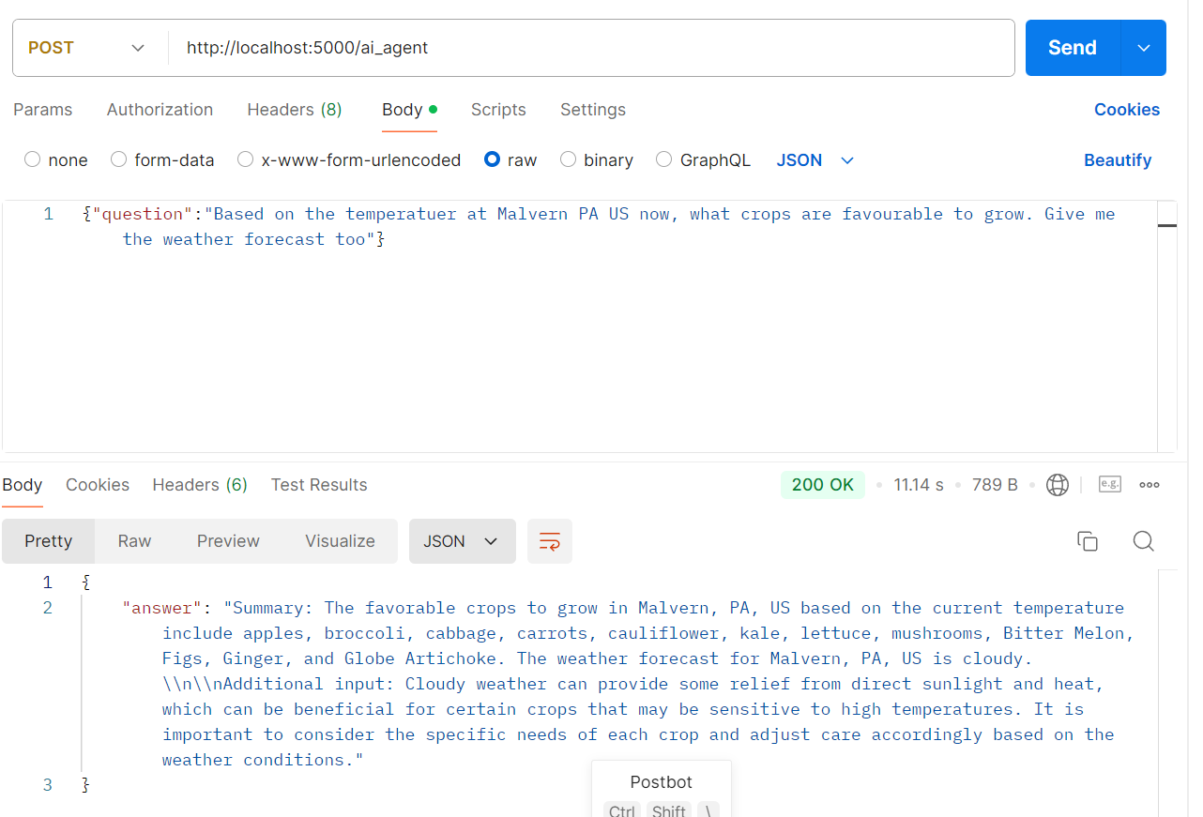
AGRI DASH
Proposed Solution
AI AGENT

Slide 5

ARGI dash
Features
1.
2.
Answer Questions of Farmers based on Real-time data & their location
RAG Architecture to answer questions based on NASA data
3.
4.
Farmers can speak in their native language and get answers in their native language
Visualize & Forecast Rain & Soil moisture data for agriculture experts

Slide 6

AGRI Dash
Work in Progress
Frontend Backend Integration
Data Collection is complete we need to visualize the data
Deployment

Slide 7
AGRI DASH
References
https://climateserv.servirglobal.net/api/getDataRequestProgress/
OpenAI LangChain
Earthdata (nasa.gov)

Slide 8

AGRI DASH
THANK YOU FOR ATTENTION

